Slide 1
Detecting Spam
on Twitter

Slide 2
Introduction
Reference paper:
Fabricio Benevenuto, Gabriel Magno, Tiago Rodrigues, and Virgilio Almeida. Detecting Spammers on Twitter, 2010^{[1]}.
Main goal:
An implementation of a spam classification model of tweet.

Slide 3
Related
Works
Juan Martinez-Romo, Lourdes Araujo, Detecting malicious tweets in trending topics using a statistical analysis of language, Expert Systems with Applications, Volume 40, Issue 8, 15 June 2013, Pages 2992-3000^{[2]}. Point of interest :
Tweet-only based study;
Use of a statistical language model;
Link analysis;
Comparison between SLM or content-based feature;
C. Chen, J. Zhang, X. Chen, Y. Xiang and W. Zhou, 6 million spam tweets: A large ground truth for timely Twitter spam detection, 2015 IEEE International Conference on Communications (ICC), London, 2015, pp. 7065-7070^{[3]}. Point of interest :
Tweet and twitter accounts based study;
Data analysis based on: CDF, link analysis of tweet with blacklist sites services and studying of Spam Ratio ;
Comparison between result of different SVM;

Slide 4
Differences
Differences:
Only spam study (no spammer) due to database availability.
Smaller number of tweets
Features plot

Slide 5
Workflow
Data analysis
SVM classification
Ranking features
Feature selection
· Filter features
· Building data train file
· CDF analysis
· Training
· SVM classification
· Understand the impact of every feature on the final result, using info_gain and chiSquare
· Repeat the classification using only best features or only worst features
· Draw the final conclusions

Slide 6
Dataset
Original dataset source:
https://www.kaggle.com/c/twitter-spam/data
Built collection:
A structure based on 11 features, derived from the original database.
Following
Followers
Actions
is_retweet
URLCounted
HashtagCounted
MensionCounted
AverageHashtag
AverageURL
WordsCounted
SpamWordsCounted
Specifics:
Ground truth: QUALITY or SPAM
11968 tweets
TXT and CSV format
Wordpress Spam words blacklist^{[4]}
Notes:
Ground truth già fatto

Slide 7
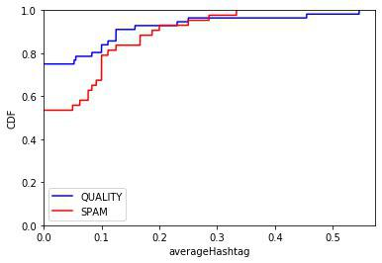
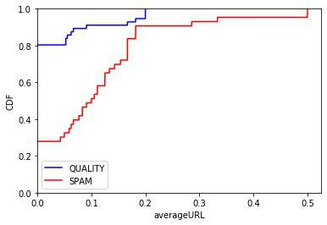
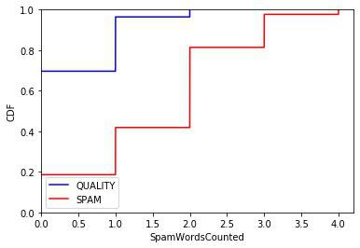
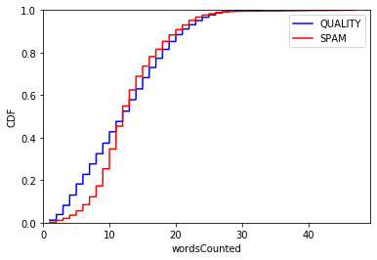
Cumulative
Distribution
Function
CDF Formula
F_{X}(x) = P(X≤x)

Slide 8
SVM
Summary
Result
All features
All features |  | Predicted
 |  | QUALITY | SPAM
True | QUALITY | 90,25% | 9,75%
 | SPAM | 7,33% | 92,67%
 | Precision | Recall | F1-score
QUALITY | 93% | 90% | 91%
SPAM | 90% | 93% | 91%

Slide 9
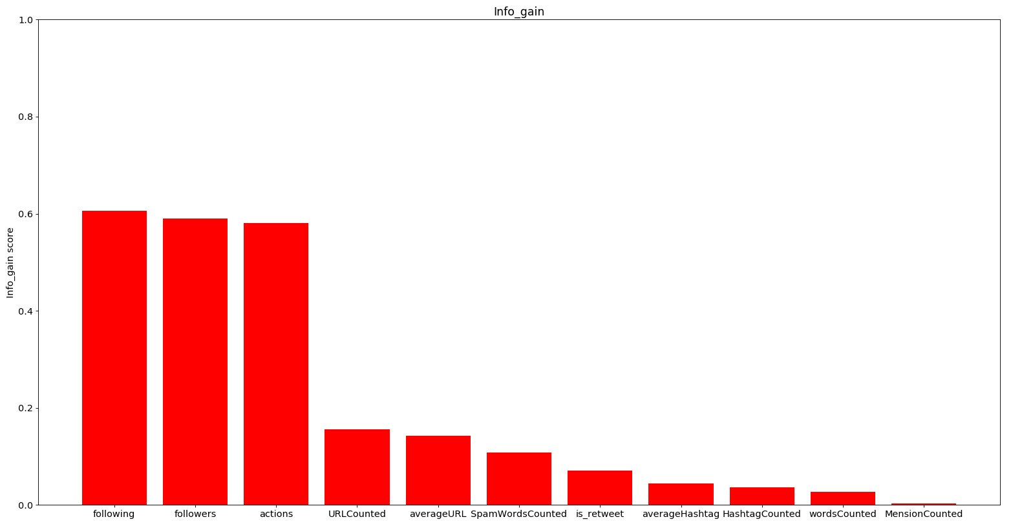
Features Ranking

Slide 10
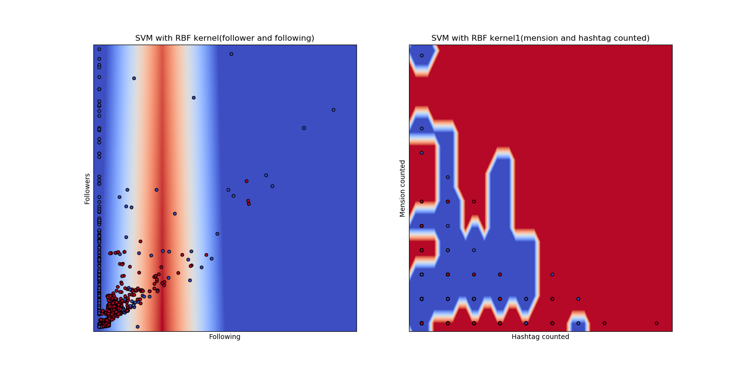
SVM Summary Result
Best 2 features
Best 2 features |  | Predicted
 |  | QUALITY | SPAM
True | QUALITY | 97,07% | 2,93%
 | SPAM | 34,42% | 65,58%
 | Precision | Recall | F1-score
QUALITY | 75% | 97% | 85%
SPAM | 95% | 66% | 78%

Slide 11
SVM Summary Result
Worst 2 features
Worst 2 features |  | Predicted
 |  | QUALITY | SPAM
True | QUALITY | 80,89% | 19,11%
 | SPAM | 53,08% | 46,92%
 | Precision | Recall | F1-score
QUALITY | 63% | 81% | 71%
SPAM | 69% | 47% | 56%

Slide 12
Conclusions
and
Future Work
Conclusion:
In order to distinguish SPAM or QUALITY:
Best features are following and follower;
Worst features are WordsCounted and MensionsCounted;
Only small improvements derived from the adding of Wordpress Spam words blacklist.
Future work:
Usage of bigger dataset;
Spammer detection;
Implementation of different classifiers.

Slide 13
References
[1] Fabricio Benevenuto, Gabriel Magno, Tiago Rodrigues, and Virgilio Almeida. Detecting Spammers on Twitter, 2010.
Link: http://homepages.dcc.ufmg.br/~fabricio/download/ceas10.pdf
[2] Juan Martinez-Romo, Lourdes Araujo, Detecting malicious tweets in trending topics using a statistical analysis of language, Expert Systems with Applications, Volume 40, Issue 8, 15 June 2013, Pages 2992-3000.
Link: https://www.sciencedirect.com/science/article/pii/S0957417412012560?via%3Dihub
[3] C. Chen, J. Zhang, X. Chen, Y. Xiang and W. Zhou, 6 million spam tweets: A large ground truth for timely Twitter spam detection, 2015 IEEE International Conference on Communications (ICC), London, 2015, pp. 7065-7070.
Link: https://ieeexplore.ieee.org/document/7249453
[4] Wordpress Spam words blacklist.
GitHub link: https://github.com/splorp/wordpress-comment-blacklist

Slide 14
THANK YOU
FOR ATTENTION
Gianmarco Cariggi
Salvatore Frontera
Davide Lo Iudice

